Slide 1
X-ray light source by inverse Compton scattering of CSR
FLS2012
2012. Mar. 6
Miho Shimada
High Energy Research Accelerator Organization, KEK

Slide 2
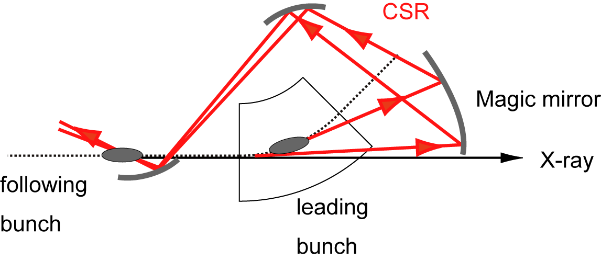
Inverse Compton scattering of CSR（CSR-ICS）
Hard X-ray and gamma-ray of laser Compton scattering
is planned at the Compact ERL.
Photon energy due to inverse Compton scattering
Head-on collision
CSR-ICS is proposed as a soft X-ray light source at the compact ERL.
laser- ICS
CSR - ICS
CSR is reflected at a mirror and
collides with the following electron bunch.
M. Shimada and R. Hajima, PRSTAB 13, 100701,(2010)

Slide 3
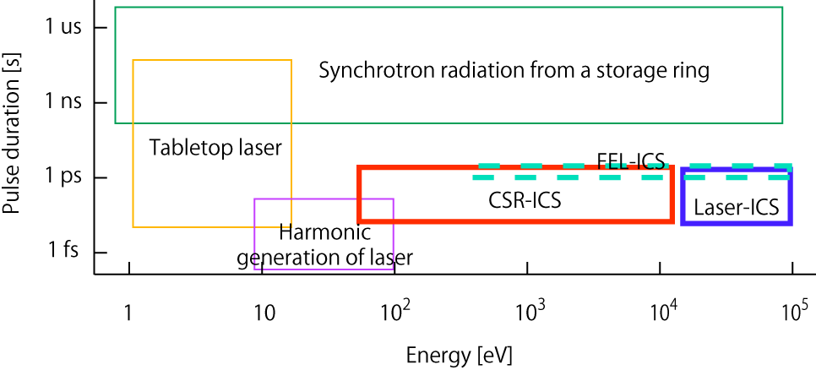
CSR-ICS at the Compact ERL
X-ray expected by the inverse Compton scattering of cERL
Corurtesy S. Adachi
This area is expected at the cERL

Slide 4
Comparison CSR-ICS with conventional ICS
 | Laser-ICS | FEL-ICS | CSR-ICS
Equipment | External laser | Undulator | Only mirror
Synchronization | Difficult | Easy | Easy
Spot size of laser (depends on wavelength) | Smaller | Smaller | Larger
Bandwidth | Narrow | Narrow | Relatively narrow ~ white light
Electron energy | Lower | Lower | Higher
Bunch compression | Difficult | Difficult | Easy
Emittance | Larger | Larger | Smaller

Slide 5
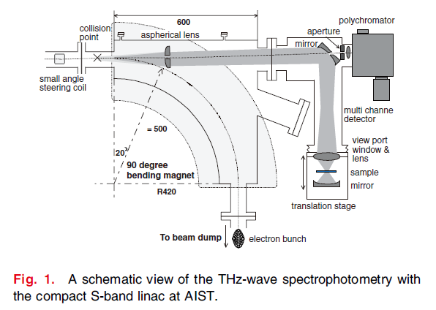
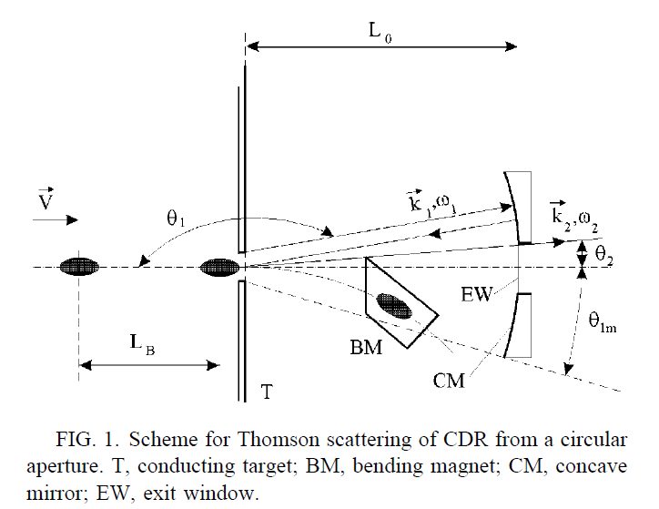
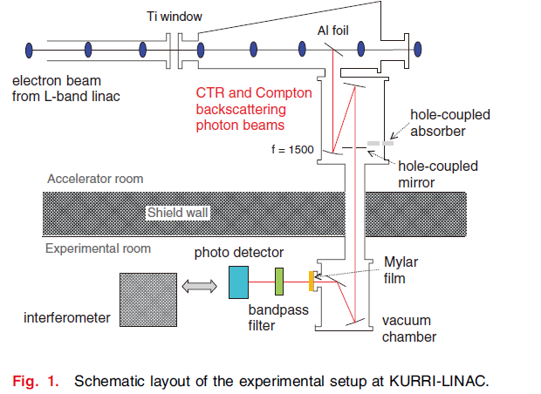
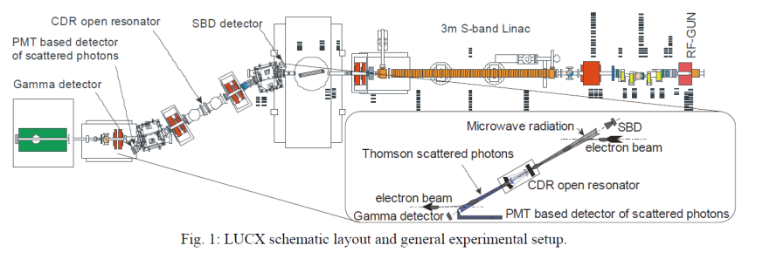
Proposals of the ICS of CSR and CDR
N. Sei et al, APEX 1, 087003,(2008)
A. P. Porylitsyn et al, PRE 60, 2272,(1999)
N. Sei and T. Takahashi, APEX 3, 052401,(2010)
A. Aryshev et al, IPAC’10, 196,(2010)
It’s proposed as a real time THz Spectroscopy.
THz is converted to visible region.
Flux is very small.
ICS of Coherent Diffraction Radiation
Compact X-ray light source.

Slide 6
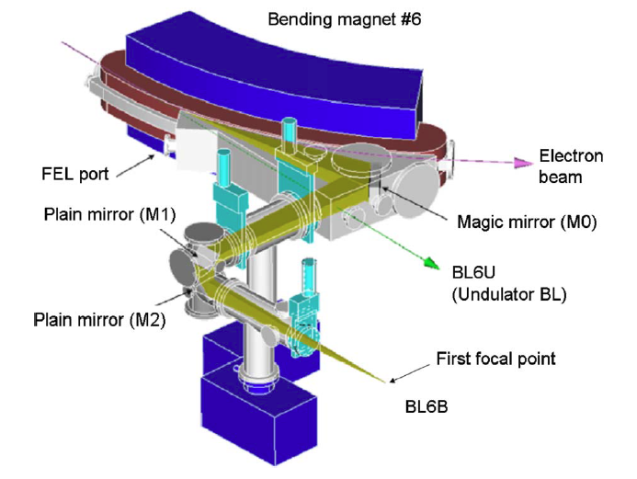
Optics 1: Magic mirror scheme for white light source I
S. Kimura et al, Infrared Phys. & Tech 49, 147,(2006)
The spot size is assumed to be the same with that of the transverse beam size, which is estimated with betatron and dispersion function.
The transverse beam size is smaller than the wavelength of CSR.
Electron Beam 200 MeV, 77 pC
Acceptance angle of magic mirror
300 mrad [H] x 20 mrad [V]
Transverse electron beam size
70 um [H] x 30 um[V]

Slide 7
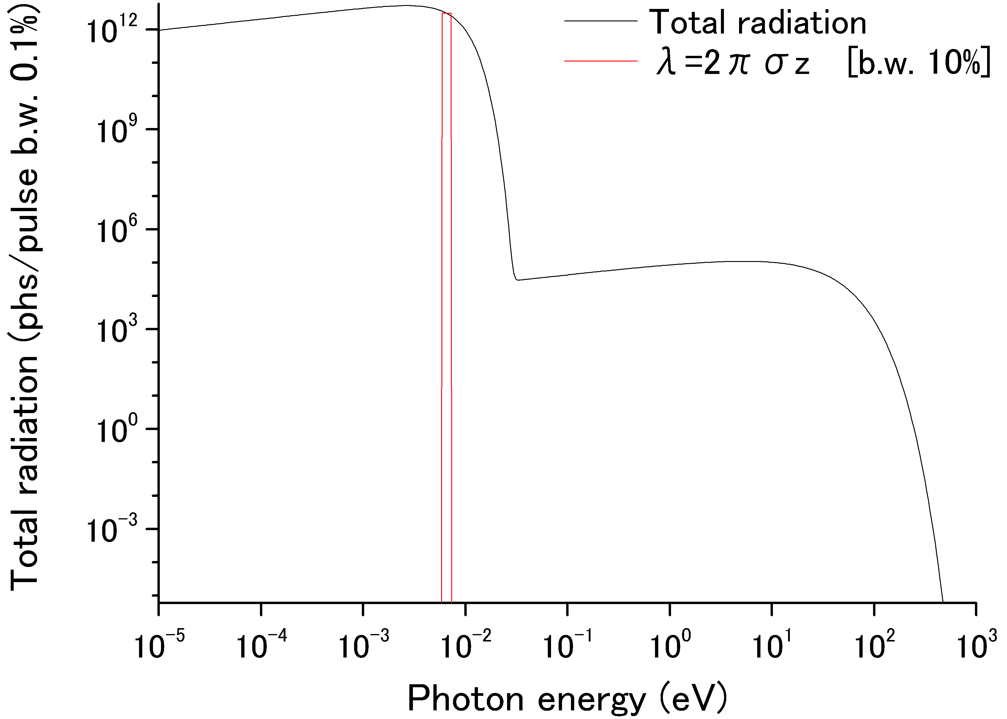
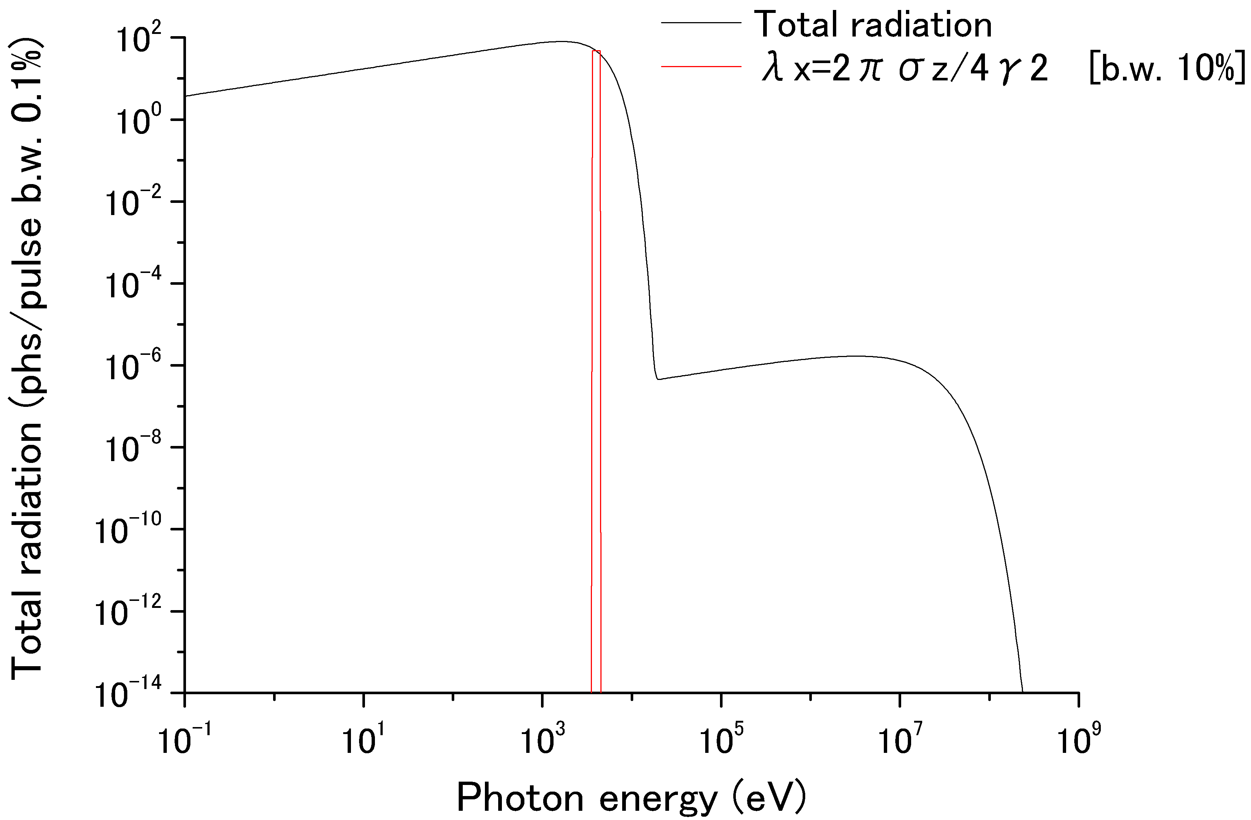
Magic mirror scheme for white light source II
Example :
Electron charge : 77pC/bunch
Electron energy : 200 MeV,
Bunch length : 100 fs
CSR (190μm)
: 3 x 10¹⁴ phs/pulse 10%BW , 4 x 10²³ phs/s 10%BW (1.3 GHz)
X-rays (4 keV)
: 5 x 10³ phs/pulse 10%BW , 6 x 10¹² phs/s 10%BW (1.3 GHz)
Scattered Photons
: 4 x 10⁵ phs/pulse 100%BW, 5 x 10¹⁴ phs/s 100%BW (1.3 GHz)
Pulse duration : 100 fs
Pulse duration of CSR becomes longer because of narrow bandwidth.
Timing jitter should be smaller than the pulse width of CSR.
The cutoff effect is ignored..

Slide 8
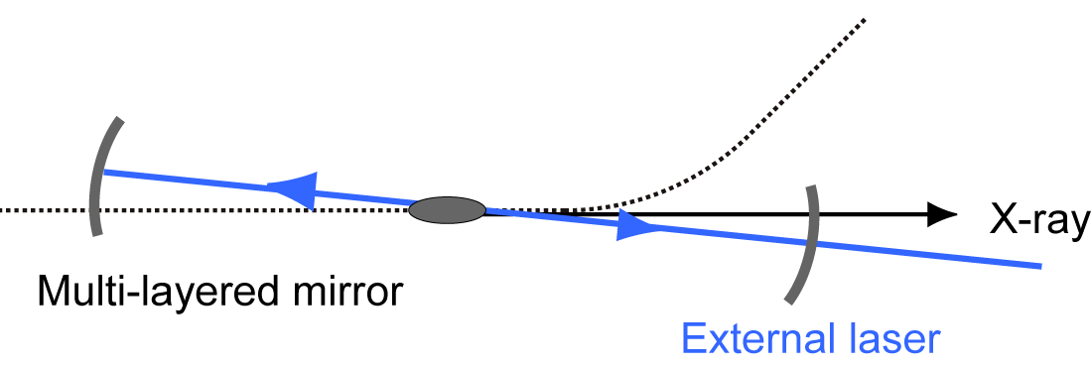
Optics 2 : Optical Cavity scheme for narrow bandwidth
CSR - ICS
ICS by an external laser
Incoherent stacking because the fluctuation of longitudinal position (a few hundreds um) is larger than wavelength of CSR.
Electron bunch emits CSR inside a cavity.
Four mirrors is necessary for two focus points. One is for collection of CSR and another is collision point.
Coherent stacking
External laser is injected from outside a cavity. It passes though a multilayered mirror with low transmittance.
Two mirrors are enough for single focus point.
E.R.Crosson et al, Rev. Sci. Instrum. 70, p.4 (1999)
P_{cav}:Power in a cavity, P_{in}:Input power, R: Reflectance, T:Transmittance, n:Number of mirrors
In both cases, pulse power is stacked by 1000 times with reflectivity of mirrors 99.97% .

Slide 9
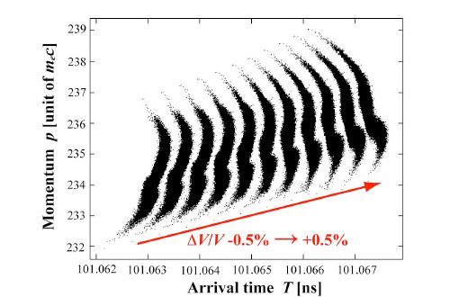
Timing jitter in cERL
Layout of a 1-loop ERL
Shift of arrival time caused by RF amplitude error
Source of error | error | Jitter of arrival time
RF amplitude | 0.1 % | 400 fs
RF phase | 0.1 degree | 200 fs
Injection timing | 200 fs | 10 fs*
*jitter of arrival time is shorter than error of injection time because it is compensated by the error of RF phase.
N. Nakamura, Proceedings of IPAC 10, p.2317-2319

Slide 10
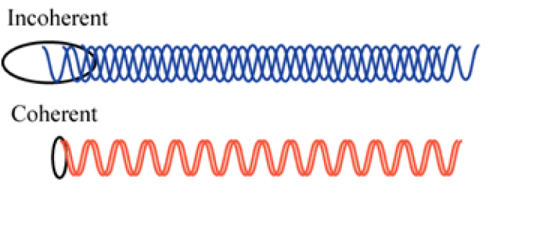
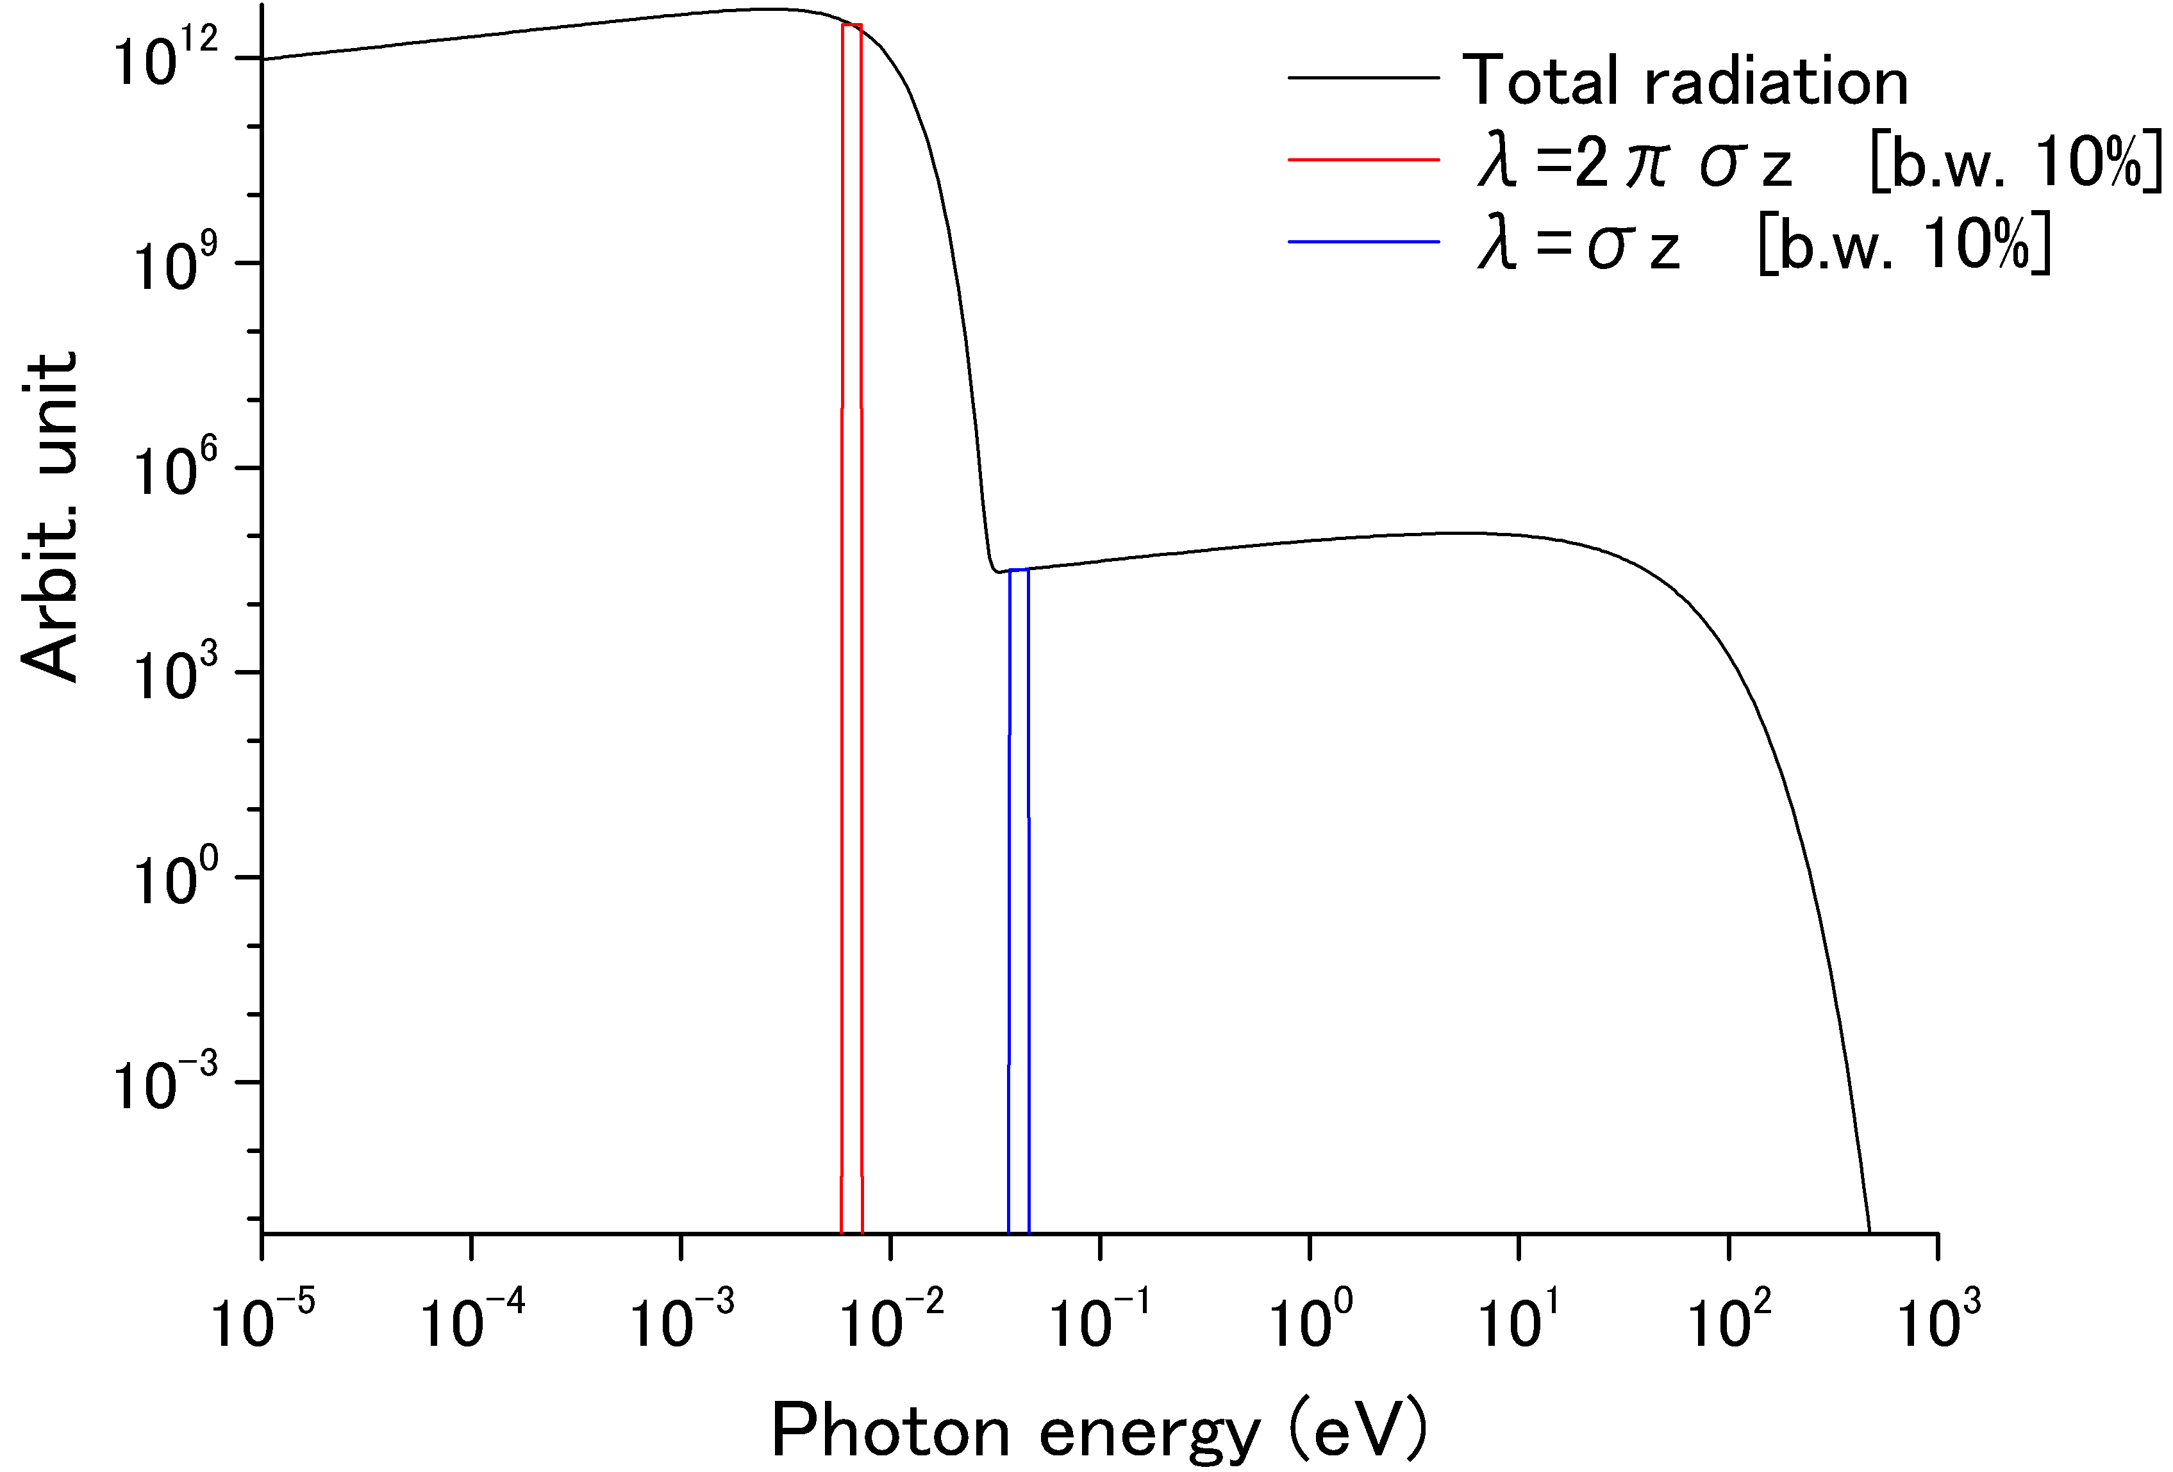
Wavelength of CSR for pulse stacking in an optical cavity
Total radiation power : P(k)
Incoherent
Coherent
P(k) : Total radiation power
N : Number of electron
p(k) : Radiation power per an electron
ρ(z) : Longitudinal electron density distribution
F(k) : Form factor
Gaussian beam with bunch length σ_{z}
Wavelength of CSR stacked in an optical cavity is chose as follows,

Slide 11
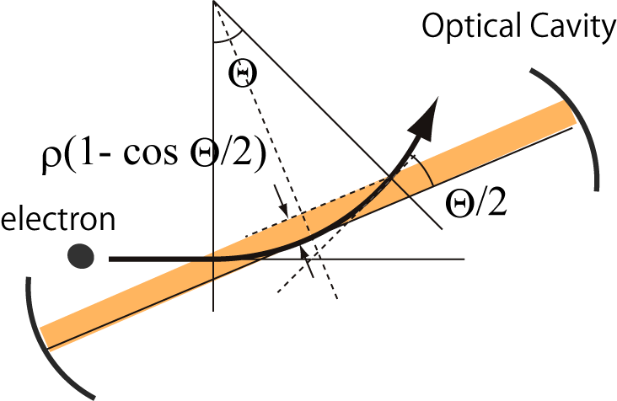
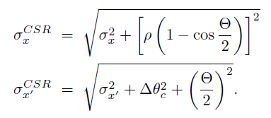
Mode matching
Acceptance angle is limited for Mode matching
Acceptance angle Θ is determined
to satisfy the mode matching.

Slide 12
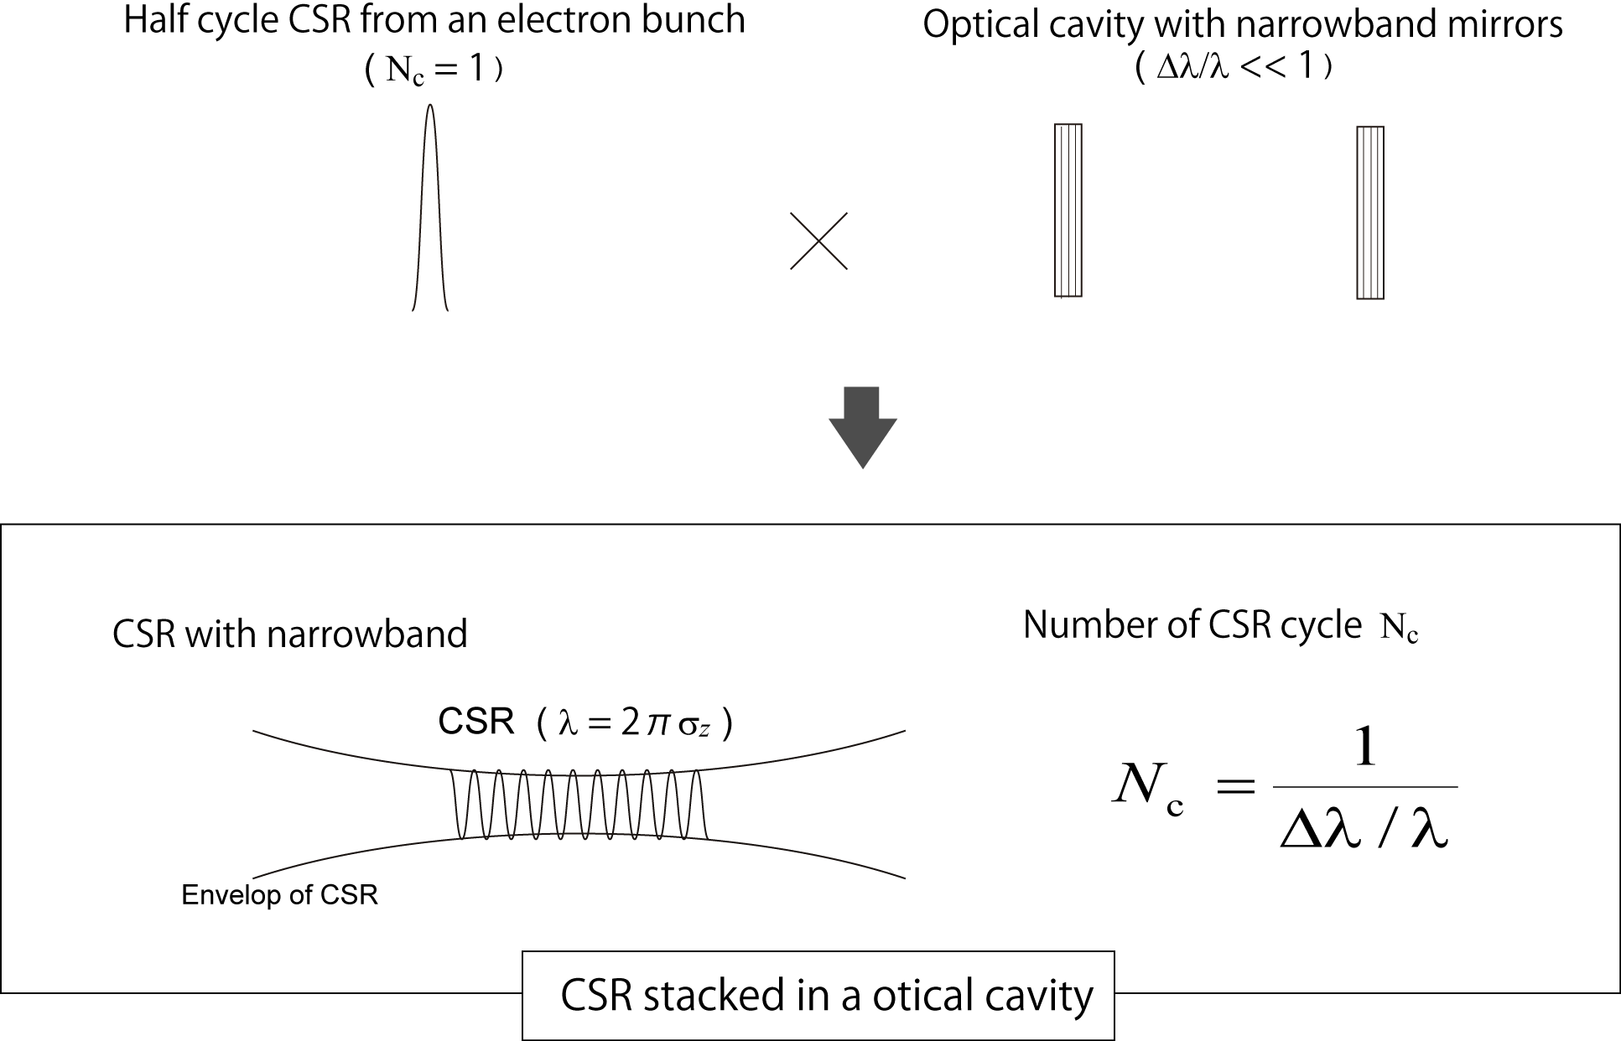
Optimization of collision area : 1
Half cycle of CSR is destroyed by an narrow band mirror.
In the case of bandwidth Δλ/λ, pulse duration of CSR is lengthened by a factor 1/(Δλ/λ).

Slide 13
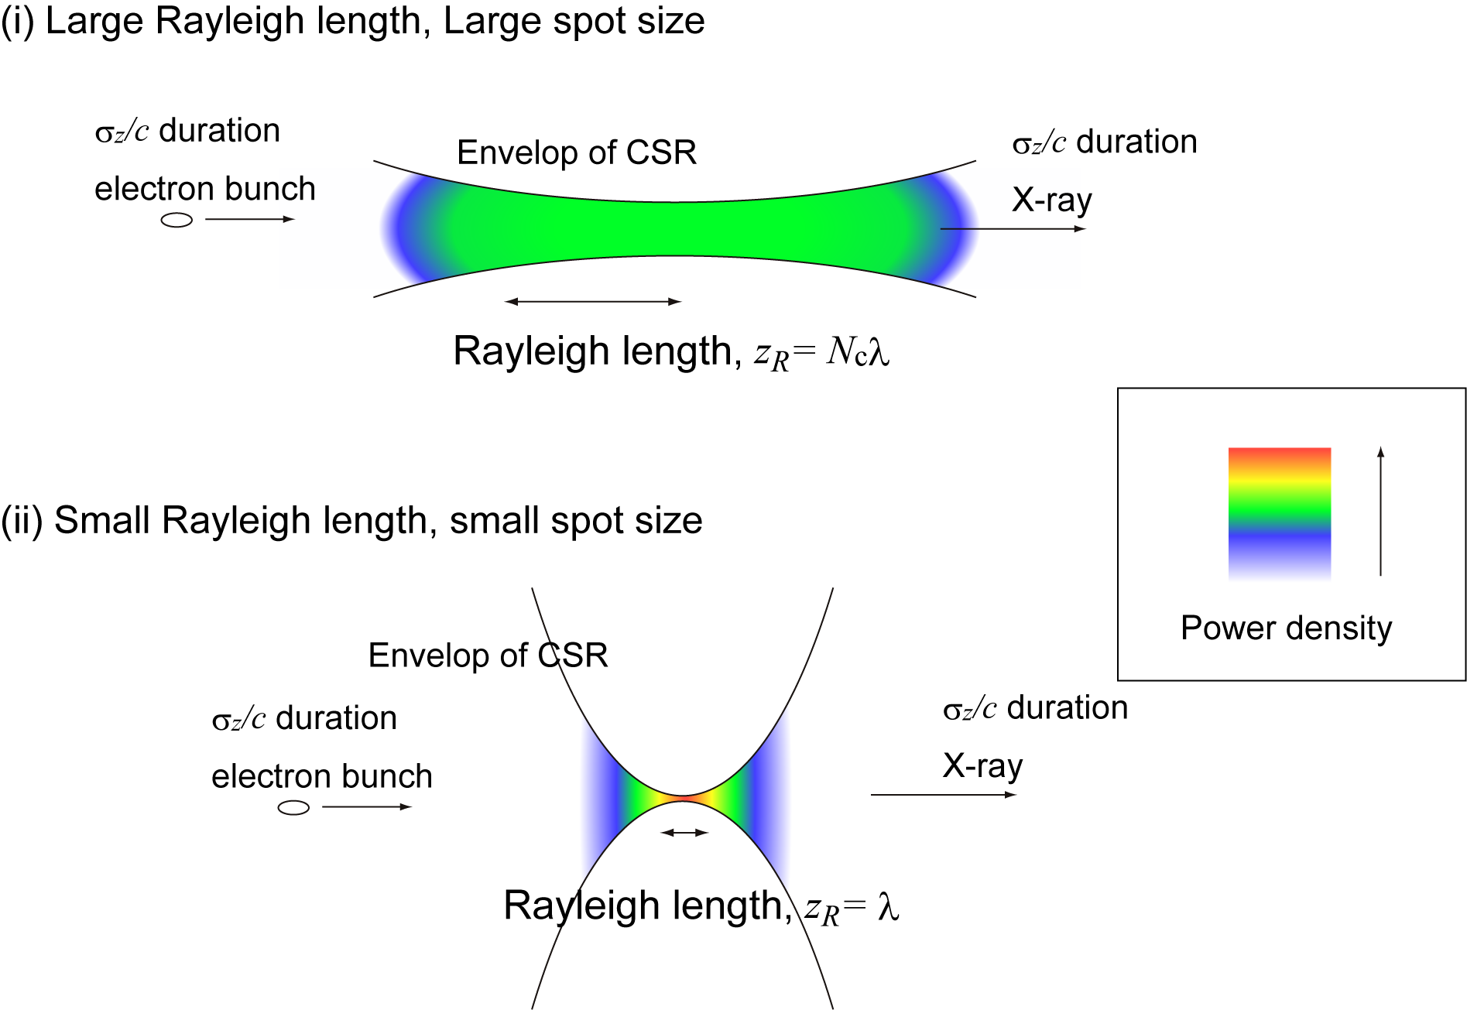
Optimization of collision area : 2
CSR in optical cavity is assumed to be Gaussian beam.
Hour glass effect is considered at the collision.
Beam size w(z) of Gaussian beam
Small z_{R} :
small spot size is easy to spread
z_{R} < λN_{c}, N_{x}is independent to z_{R}.
The Rayleigh length is z_{R} = λN_{c},
to minimize the effect of the timing jitter of electron bunches.
to avoid the non-linear effects.

Slide 14
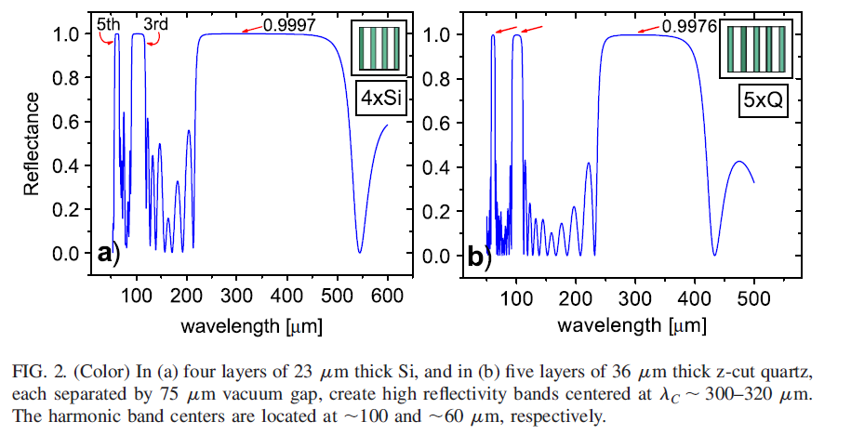
High reflectivity mirror
In the wavelength range of a few 10 um ～a few 100 um,
Reflectivity of metal is lower than 98 %.
It is difficult to fabricate multilayered mirror with larger than 99% reflectivity by conventional method.
Development of high reflectivity mirror for terahertz region
M.Tecimer et al, PRSTAB 13,
030703,(2010)
Stacking up photonic crystal separated by vacuum layer.
Bandwidth is narrow at the higher order wavelength.
Wavelength, which depends on thickness of the layers, is controllable without losing the high-reflectivity.

Slide 15
X-ray at 60-200 MeV ERL
Number of photons of X-ray (b.w.10%)
Number of photons per pulse : ~ 10⁴⁻⁵ phs/pulse.
Flux : ~ 10¹³⁻¹⁴ phs/s.
Energy range of X-ray
From 0.04 to 4 keV.
10 keV X-ray is possible at electron energy of 200 MeV and bunch length 50 fs, which is accomplished in tracking simulation.
Pulse duration of X-ray is 100 fs – 1 ps.
Electron transverse beam size is much smaller than the focus size of focused CSR.

Slide 16
Summary
We proposed the inverse Compton scattering of CSR.
ERL is a nice platform for both high-intensity CSR source and inverse Compton scattering.
Two optical schemes
Magic mirror : White light with pulse duration of 100 fs.
Optical cavity : Narrow bandwidth. Power amplification by pulse stacking is estimated almost 1000 times.
Scattered photon expected in ERL (Optical cavity)
Generation of soft X-ray with energy range of 0.04 – 4 keV is expected at 200 MeV ERL. Pulse duration is from 100 fs to 1 ps.
Number of photon per pulse is 10⁴⁻⁵ phs/pulse, Flux 10¹³⁻¹⁴ phs/s.

